Slide 1


Slide 2
Jargons
DAG Driver Partition Jobs
RDD SparkContext Transformations Actions
Executors Lazy Evaluation Jargons
Stages Coalesce Repartition In-Memory

Slide 3

What is Spark?
Apache Spark is a distributed computing engine used for analytical processing of very large Datasets.
Developed in 2009 in UC Berkeley’s AMPLab by Matei Zaharia.
largest open source community in big data.
Sparks are any small particles that become so hot that they start to glow.
Notes:
Spark is part of the Hadoop ecosystem and is built on top of Hadoop.

Slide 4
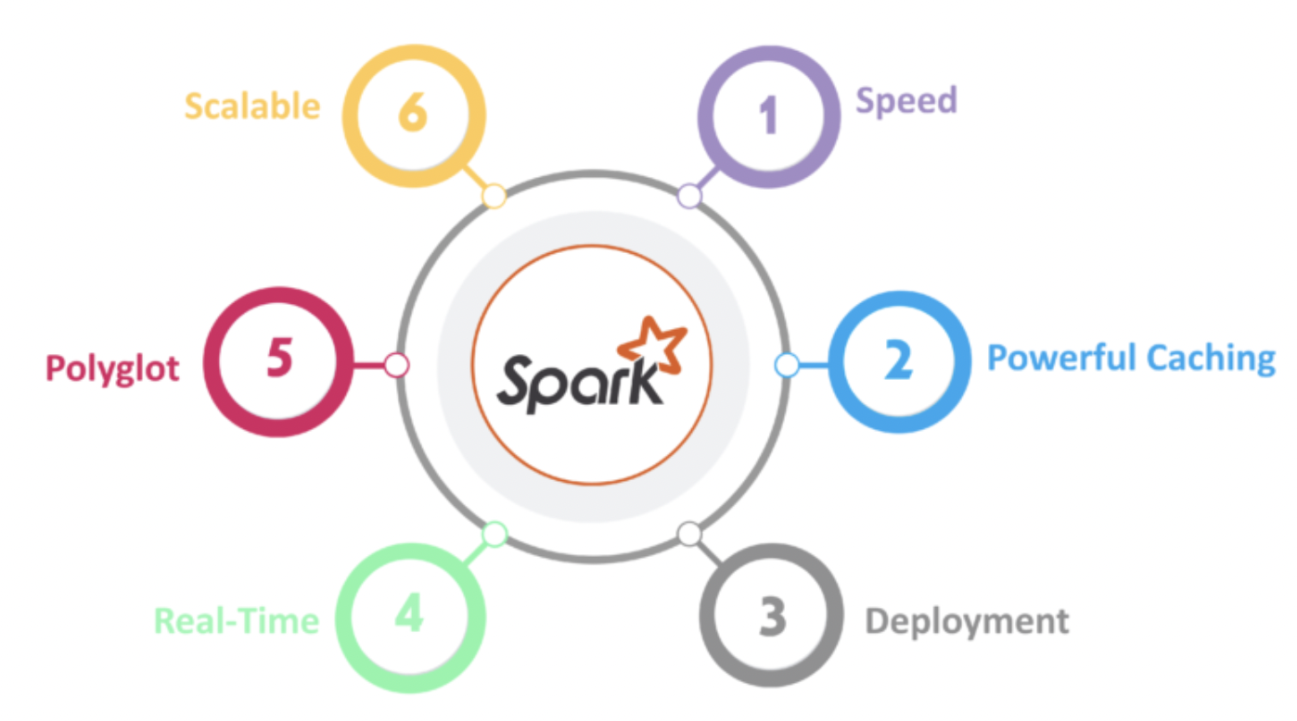
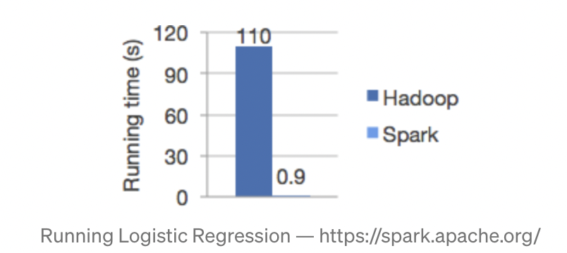
Features of Spark
In-memory computation
Ease of use
Speed
Fault Tolerance
Lazy Evaluation
Native integration with Java, Python, Scala and R
It handles batch, interactive, and real-time within a single framework

Slide 5
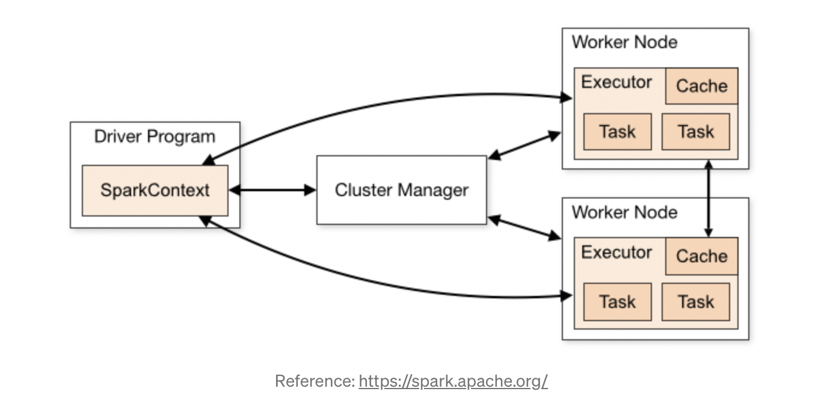
Spark Architecture

Slide 6
Spark Architecture
Driver: It is heart of a spark application and it manages the information during the lifetime of the application. It runs our main() function also sends app code and tasks to the executors.
Executor: Executor process is responsible for actually carrying out the work that the driver assigns them.
Cluster Manager: Allocate resources across applications. Supports several cluster managers (Standalone,Hadoop YARN and Kubernates)

Slide 7
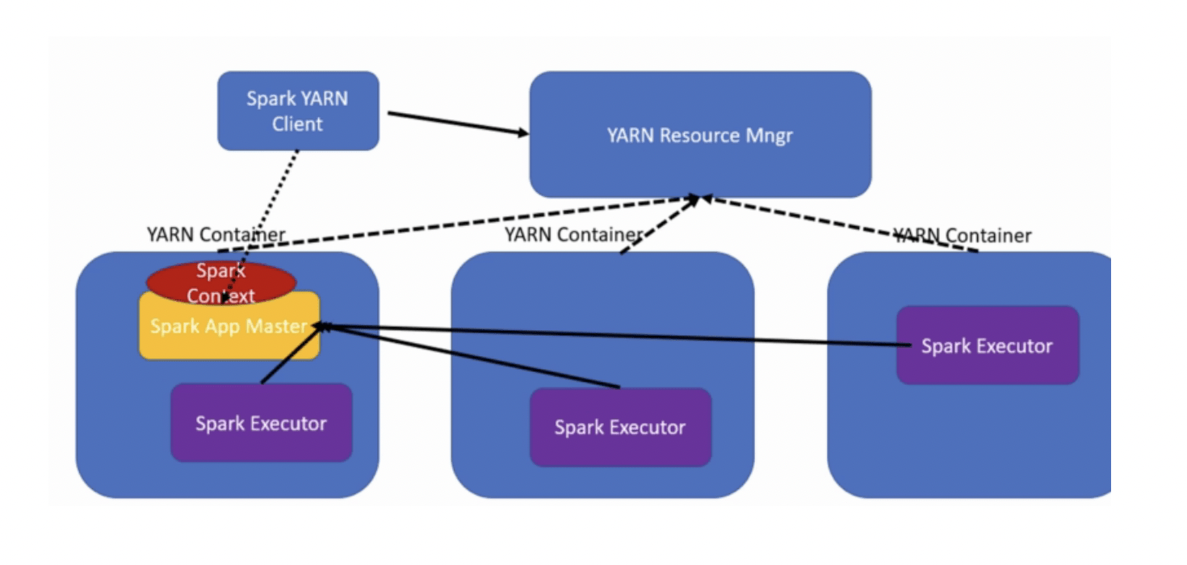
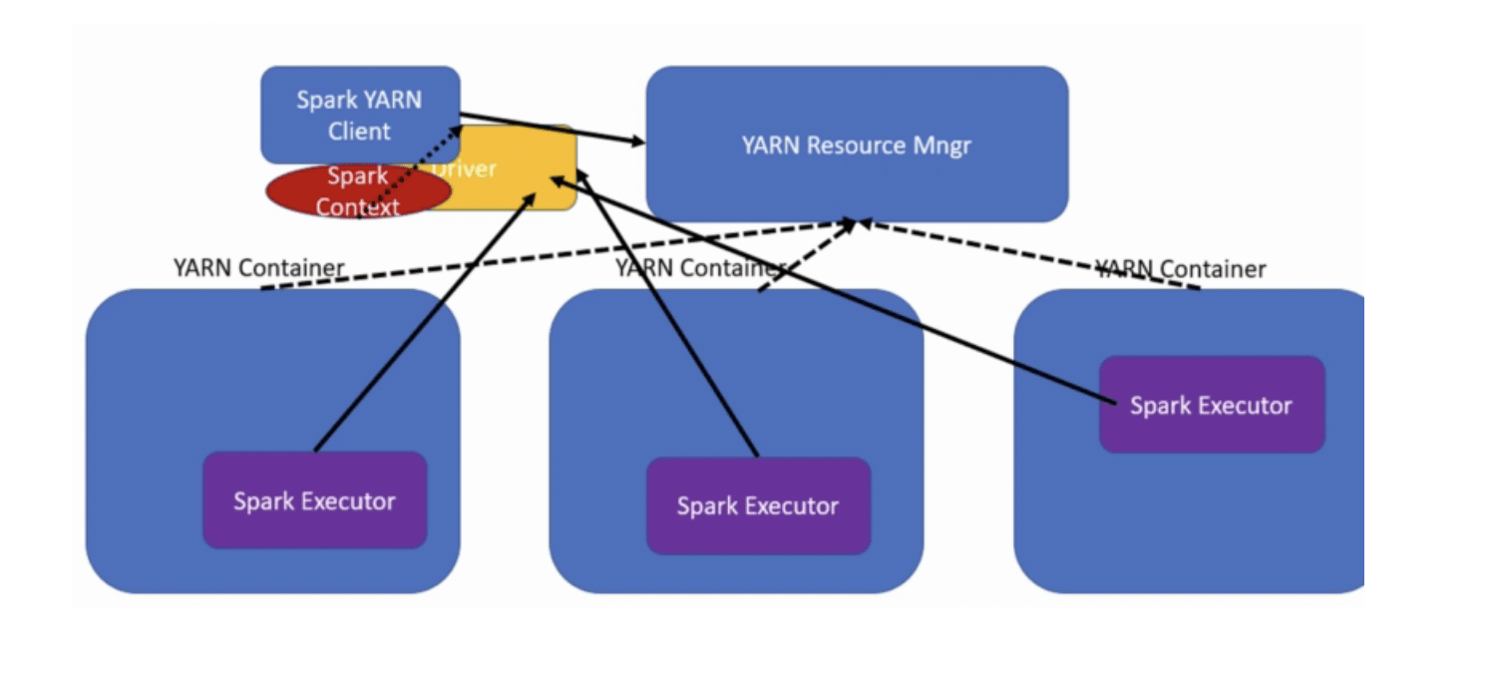
Deploy Modes
Cluster: In cluster mode, the driver runs on one of the worker nodes, used to run production jobs.
Client: the driver runs locally from where you are submitting your application used for interactive and debugging purposes

Slide 8
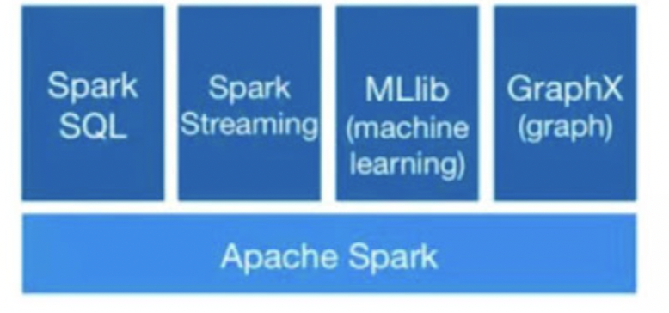
Spark Modules

Slide 9
Spark Modules
Spark SQL: The implementation here is DataFrame, which is a relational representation of the data. It provides functions with SQL like capabilities. Also, we can write SQL like queries for our data analysis.
Spark Streaming: This library provides capabilities to process/transform data in near real-time.
MLlib: This is a Machine Learning library with commonly used algorithms including collaborative filtering, classification, clustering, and regression.
GraphX: This library helps us to process Graphs, solving various problems (like Page Rank, Connected Components, etc) using Graph Theory.

Slide 10
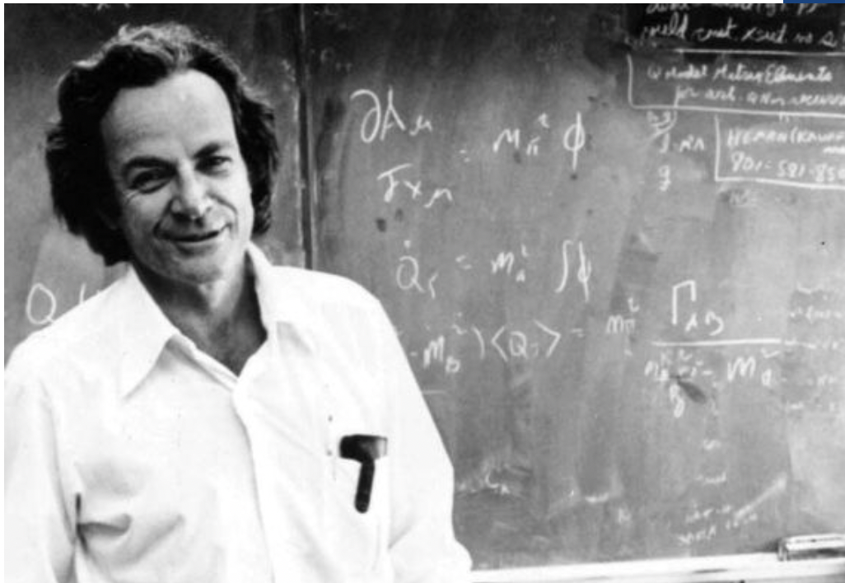
“….I believe it is the atomic hypothesis that all things are made of atoms — little particles that move around in perpetual motion, attracting each other when they are a little distance apart, but repelling upon being squeezed into one another. In that one sentence, you will see, there is an enormous amount of information about the world, if just a little imagination and thinking are applied….. “
Notes:
Richard Feynman on the One Sentence to Be Passed on to the Next Generation: if, in some cataclysm, all of scientific knowledge were to be destroyed, and only one sentence passed on to the next generation of creatures, what statement would contain themost information in the fewest words?

Slide 11
Resilient Distributed Dataset (RDD)
RDD are the primary abstraction in Spark – a fault-tolerant collection of elements that can be operated on in parallel.
Resilient: Fault-tolerant and is capable of rebuilding data on failure
Distributed: Distributed data among the multiple nodes in a cluster
Dataset: Collection of partitioned data with values

Slide 12
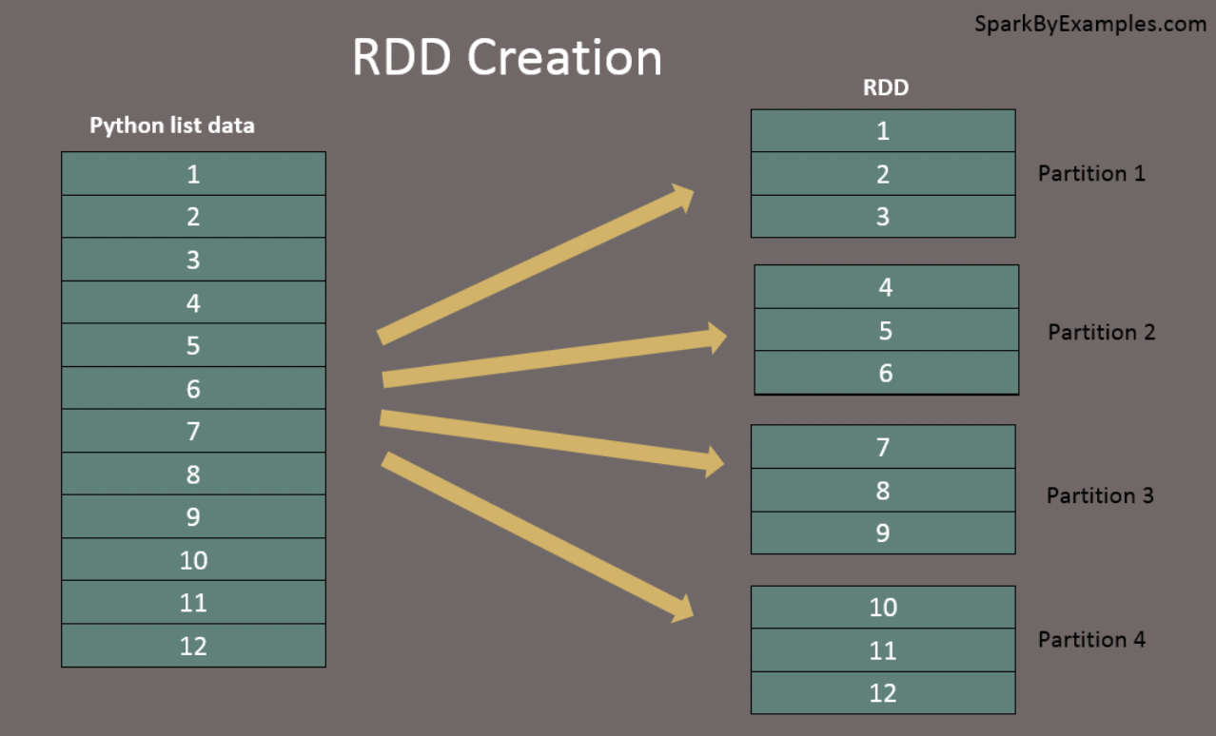
Creating RDD
Two ways:
parallelized collections data = [1,2,3,4,5,6,7,8,9,10,11,12] rdd=spark.sparkContext.parallelize(data)
referencing a dataset in an external storage system (HDFS, S3 etc.) rdd2 = spark.sparkContext.textFile("/path/textFile.txt")
Two types of operations on RDDs: transformations and actions

Slide 13
Lazy Evaluation
Transformations: When you apply a transformation on a RDD it will not be evaluated immediately but will only be stored in a DAG (Directed Acyclic Graph) and will be evaluated at some later point of time after an action is executed.
Two types of transformations:
Narrow transformations
Wide transformations

Slide 14
Types of Transformations
Narrow transformation: The result of the narrow transformation is such that in the output RDD each of the partitions have records that are from the same partition in the parent RDD. Operations like Map, FlatMap, Filter, Sample come under narrow transformations.
Wide transformations: The data in each of the partitions of the resulting RDD comes from multiple different partitions in the parent RDD. Transformation functions like groupByKey(), reduceByKey() fall under the category of wide transformation.

Slide 15
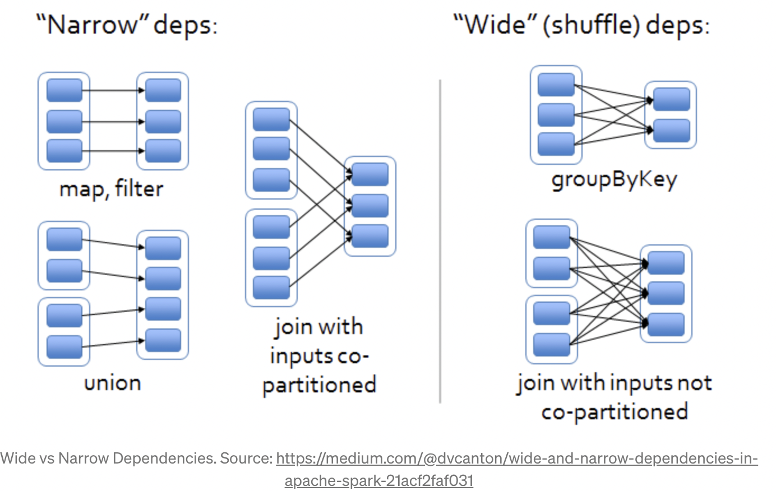
Types of Transformations

Slide 16
Transformations
Transformation | Meaning
map(func) | Return a new distributed dataset formed by passing each element of the source through a function func.
filter(func) | Return a new dataset formed by selecting those elements of the source on which func returns true.
flatMap(func) | Similar to map, but each input item can be mapped to 0 or more output items (so func should return a Seq rather than a single item).
coalesce(numPartitions) | Decrease the number of partitions in the RDD to numPartitions. Useful for running operations more efficiently after filtering down a large dataset.
repartition(numPartitions) | Reshuffle the data in the RDD randomly to create either more or fewer partitions and balance it across them. This always shuffles all data over the network.
intersection(otherDataset) | Return a new RDD that contains the intersection of elements in the source dataset and the argument.

Slide 17
Actions
Action | Meaning
collect() | Return all the elements of the dataset as an array at the driver program. This is usually useful after a filter or other operation that returns a sufficiently small subset of the data.
count() | Return the number of elements in the dataset.
take(n) | Return an array with the first n elements of the dataset.
first() | Return the first element of the dataset (similar to take(1)).
saveAsTextFile(path) | Write the elements of the dataset as a text file (or set of text files) in a given directory in the local filesystem, HDFS or any other Hadoop-supported file system. Spark will call toString on each element to convert it to a line of text in the file.
Notes:
For more: https://spark.apache.org/docs/latest/rdd-programming-guide.html

Slide 18
Caching Data
cache() method is used to cache the intermediate results of the transformation into memory so that any future transformations on the results of cached transformation improve the performance.
Caching is a lazy evaluation meaning it will not cache the results until you call the action operation
Caching is one of the optimization tricks to improve the performance of the long-running PySpark applications/jobs.

Slide 19
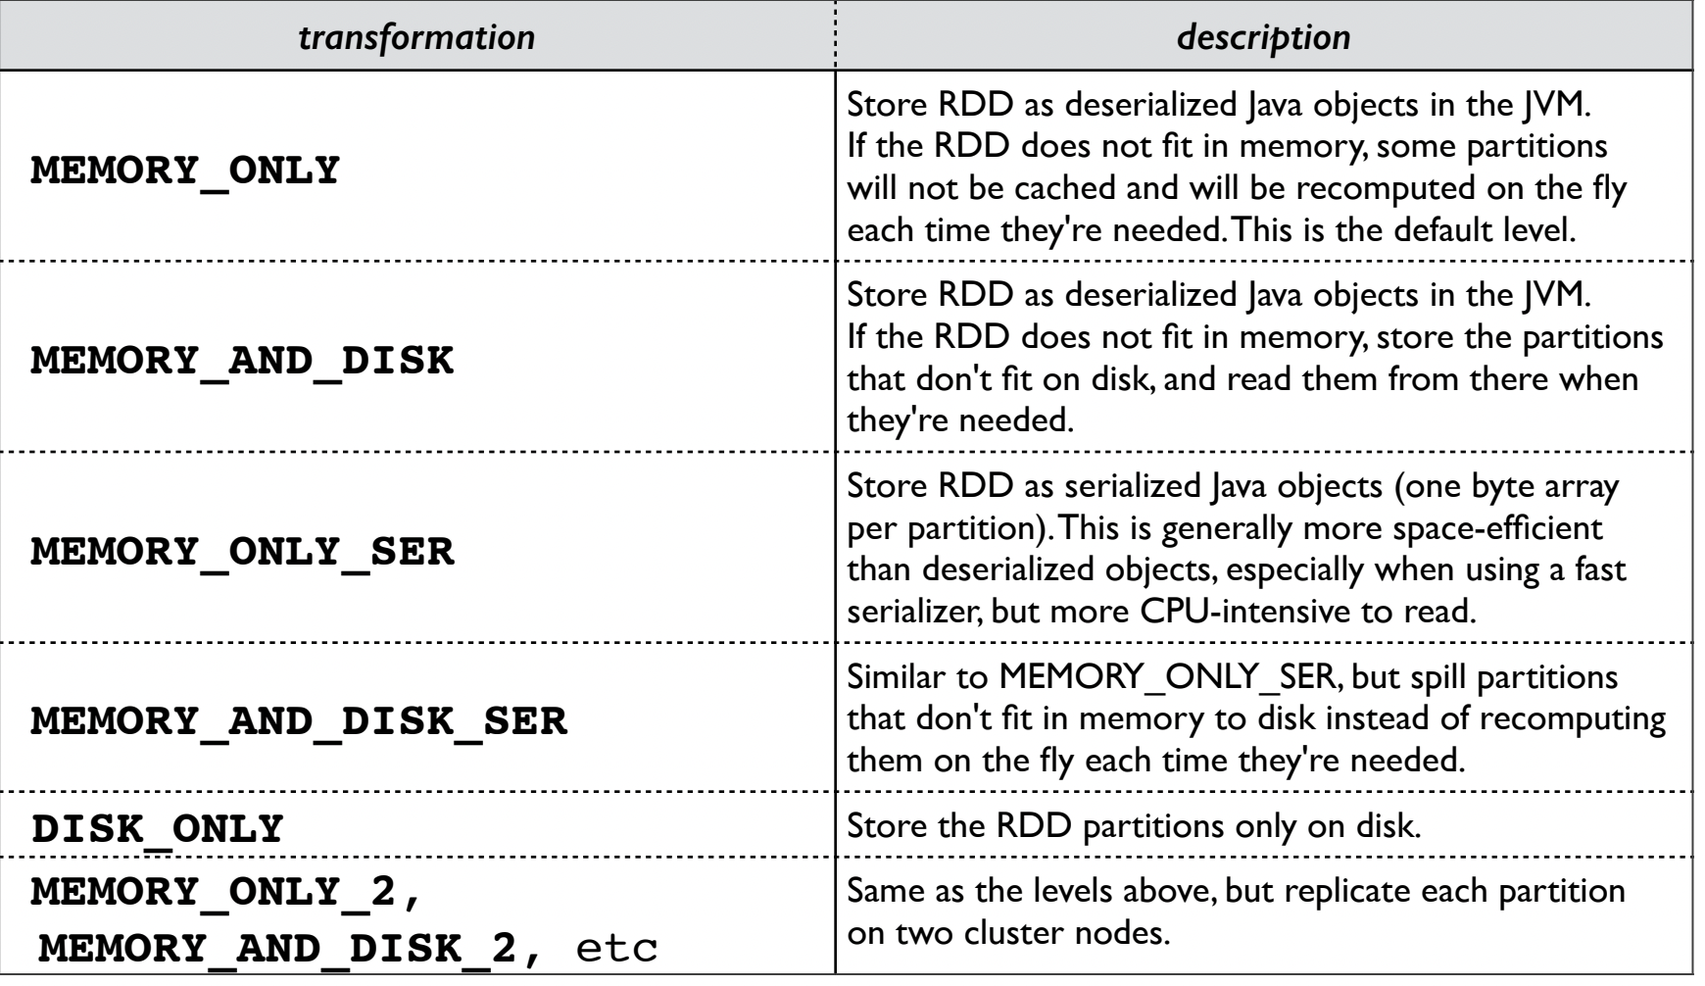
Caching Data
persist() method is used to cache the intermediate results of the transformation but with options of different storage level.

Slide 20
DAG (Directed Acyclic Graph )
Vertices are RDDs and Edges are operations.
Acyclic -Transformation cannot return to the older partition.
On the calling of Action, the created DAG submits to the DAG Scheduler which further splits the graph into the stages of the task.
A stage is comprised of tasks based on partitions of the input data.

Slide 21
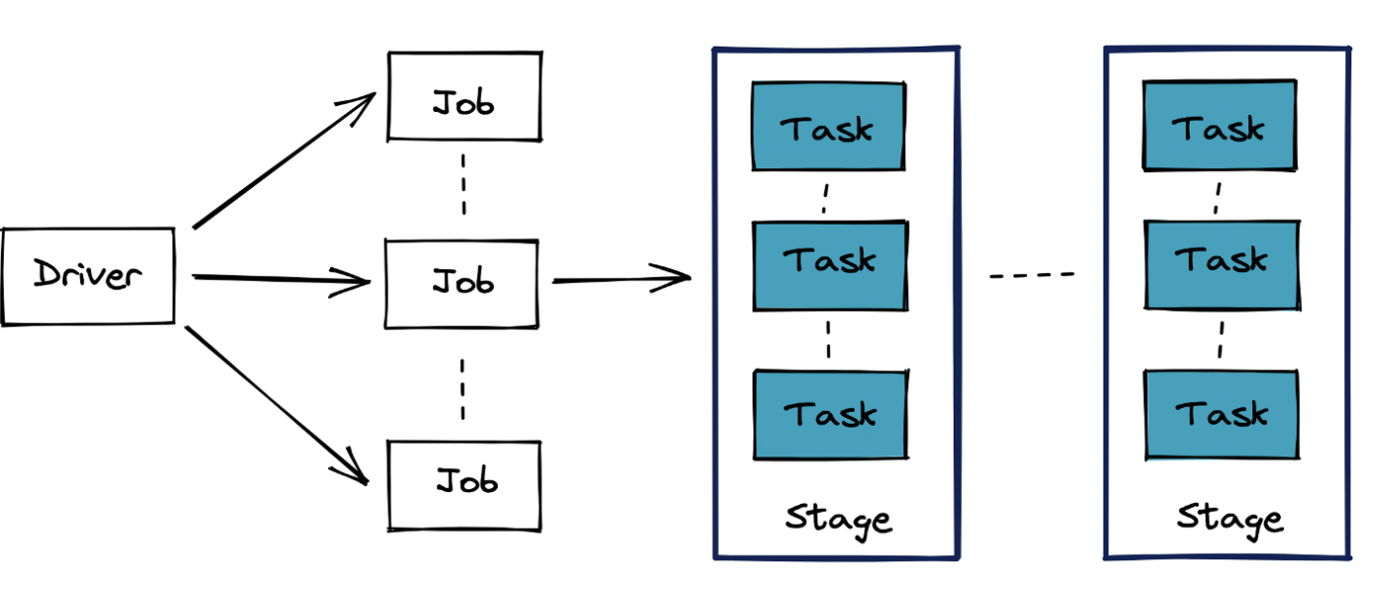
Some Keywords…
Spark Application : An application comprises several jobs. A job is created, whenever you execute an action function like write().
Job: A job comprises several stages. When Spark encounters a function that requires a shuffle it creates a new stage. Transformation functions like reduceByKey(), Join() etc will trigger a shuffle and will result in a new stage. Spark will also create a stage when you are reading a dataset.
Task : Task is the smallest execution unit in Spark. A task in spark executes a series of instructions. For eg. reading data, filtering and applying map() on data can be combined into a task. Tasks are executed inside an executor.
Stage: A stage comprises several tasks and every task in the stage executes the same set of instructions.

Slide 22
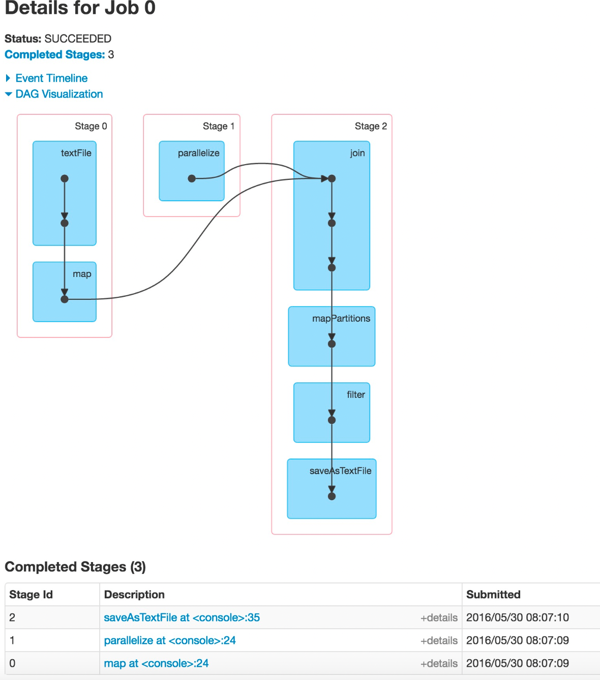
// Pseudocode rdd1 = sc.textFile("/data/blah/input")\ .map(lambda x: (x.id,x.gender,x.salary*2))
rdd2 = sc.parallelize(range(100))
rdd3 = rdd1.join(rdd2)
rdd4 = rdd3.mapPartitions(someFunc)
rdd5 = rdd4.filter(x.salary>=50000)
rdd5.saveAsTextFile("/data/blah/out")

Slide 23
Datasets
A Dataset is a distributed collection of data (added Spark 1.6 ).
No named Columns.
Only Available in Scala and Java.

Slide 24
DataFrames
DataFrames are the distributed collections of data, organized into rows and columns. Each column in a DataFrame has a name and an associated type.
DataFrames are built on top of RDDs.
How to create?
from RDD (using toDF() )
from SparkSession
from Data sources

Slide 25
Word Count Example
text_file = sc.textFile("hdfs://...")
counts = text_file.flatMap(lambda line: line.split(" ")) \
.map(lambda word: (word, 1)) \
.reduceByKey(lambda a, b: a + b)
counts.saveAsTextFile("hdfs://...")

